Slide 1


Virtual Internship Experience
Created by: Daniel Jeffry

Slide 2

Teble of Contents
Problem Research
Data Pre-Processing
Data Visualization and Business Insight
Machine Learning Implementation and Evaluation
Business Recommendation

Slide 3
Problem Research

Slide 4
Problem Research
In this project, we will take an initial look at the Home Credit default Risk machine learning. The objective of this data is to use historical loan application data to predict whether or not an applicant will be able to repay loan. This is a standard supervised classification task:
Supervised: The labels are included in the training data and goal is to train a model to learn to predict the labels from the features.
Classification: The label is a binary variable, 0 (will repay loan on time), 1(will have difficulty repaying loan)

Slide 5
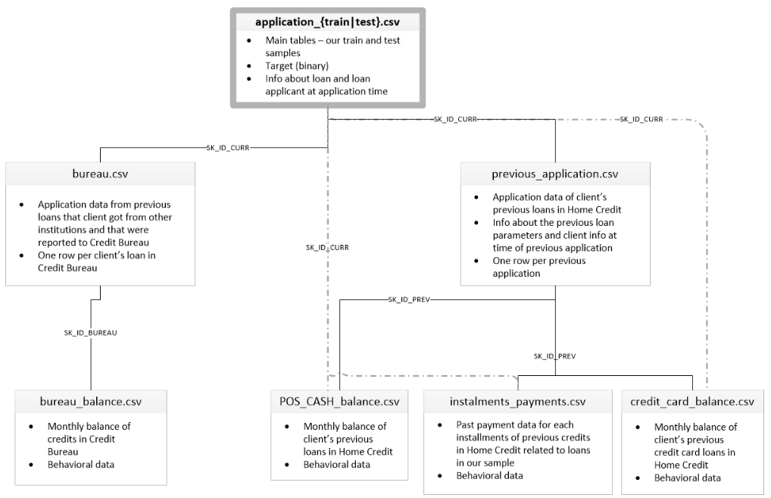
Data description

Slide 6
Description
Application_{train|test}.csv
This is the main table, broken into two files for Train (with target) and Test (without target)
Static data for all applications. One row represents one loan in our data sample.
Bureau.csv
All client’s previous credits provided by other financial institutions that were reported to Credit Bureau.
For every loan in our sample, there are as many rows as number of credits the client had in Credit Bureau before the application date.
Bureau_balance.csv
Monthly balances of previous Credit Bureau
POS_CASH_balance.csv
Monthly balance snapshots of previous point of sales and cash loans that the applicant had with Home Credit.

Slide 7
Description
credit_card_balance.csv
Monthly balance snapshots of previous credit cards that the applicant has with Home Credit.
Previous_application.csv
All previous applications for Home Credit loans of clients who have loans in our sample.
There is one row for each previous applications related to loans in our data sample.
Installments_payments.csv
Repayment history for the previously disbursed credits in Home Credit related to the loans in our sample.
There is on row for every payment that was made plus and one row each for missed payment.

Slide 8
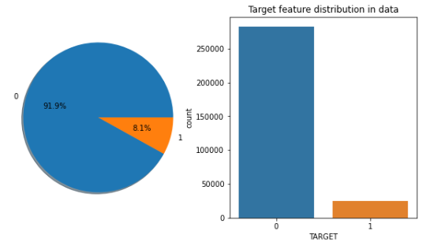
Examine the distribution of the target column
The target is what we are asked to predict: either 0 for the loan was repaid on time, or 1 indicating the client had payment difficulties. We can first examine the umber of loans falling into each category.
From this information, we see this is an imbalanced class problem. There are far more loans that were repaid on time than loans that were not repaid. Once we get into more sophisticated machine learning models, we can weight the classes by their representation in the data to reflect this imbalance.

Slide 9
Data Cleaning

Slide 10
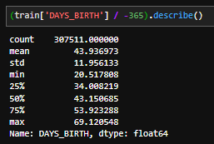
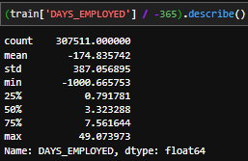
Anomalies Data
Those ages look reasonable. There are no outliers for the age on either the high or low end.
That doesn’t look right. The maximum values (besides being positive) is about 1000 years.
Just out of curiousity, let’s subset the anomalous clients and see if they tend to have higher or low rates of default than the rest of the clients.

Slide 11
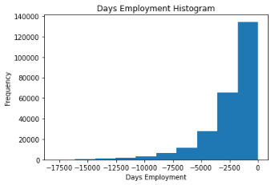
Anomalies Data
The non-anomalies default on 8.66% of loans
The anomalies default on 5.40% of loans
There are 555347 anomalous days of employment
Well that’s extremely interesting! It turns out that the anomalies have a lower rate of default.
The distribution looks to be much more in line with what we would expect, and we also have created a new column to tell the model that these values were originally anomalous (becuase we will have to fill in the nans with some value, probably the median of the column). The other columns with DAYS in the dataframe look to be about what we expect with no obvious outliers.

Slide 12
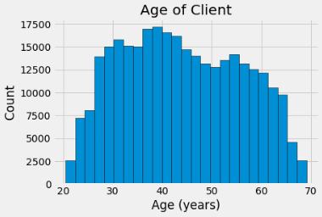
Effect on Age on Repayment
As the client gets older, there is negative linear relationship with the target meaning that as clients get older, they tend to repay their loans on time more often. Let’s start looking at this variable. First, we can make a histogram of the age. We will put the x axis in years to make the plot a little more understandable.

Slide 13
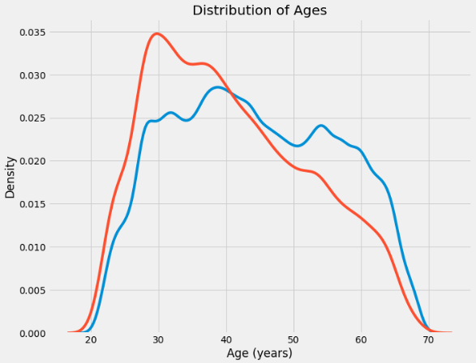
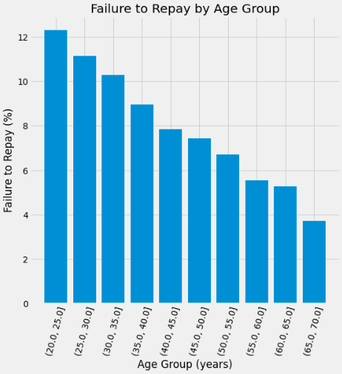
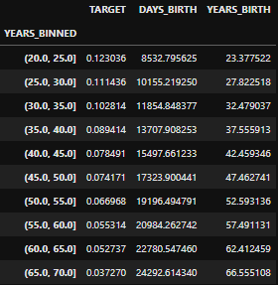
Effect on Age on Repayment
By itself, the distribution of age does not tell us much other than that there are no outliers as all the ages are reasonable. To visualize the effect of the age on the target, we will next make a kernel density optimation plot (KDE) colored by the value of the target.

Slide 14
Effect on Age on Repayment
The target == 1 curve skews towards the younger end of the range. Although this is not a significant correlation (-0.07 correlation coefficient), this variable is likely going to be useful in a machine learning model because it does affect the target.
We cut the age category into bins of 5 years each. Then, for each bin, we calculate the average value of the target, which tells us the ratio of loans that were not repaid in each age category.
This is information that could be directly used by the bank: because younger clients are less likely to repay the loan, maybe they should be provided with more guidance or financial planning tips. This does not mean the bank should discriminate against younger clients, but it would be smart to take precautionary measures to help younger clients pay on time.

Slide 15
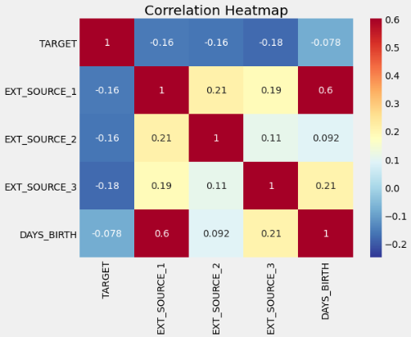
Exterior Sources
The 3 variables with the strongest negative correlations with the target are EXT_SOURCE_1, EXT_SOURCE_2, and EXT_SOURCE_3. According to the documentation, these features represent a "normalized score from external data source".
All three EXT_SOURCE features have negative correlations with the target, indicating that as the value of the EXT_SOURCE increases, the client is more likely to repay the loan

Slide 16
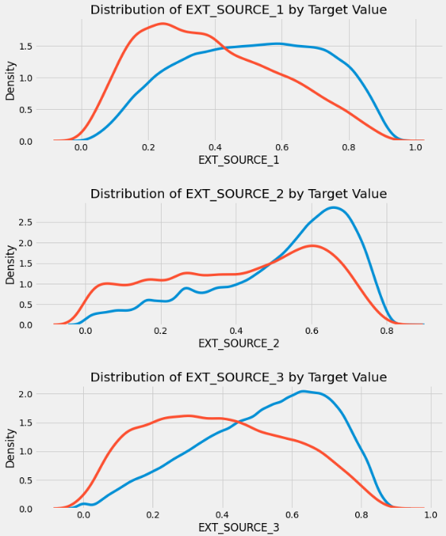
Exterior Sources
EXT_SOURCE_3 displays the greatest difference between the values of the target. We can clearly see that this feature has some relationship to the likelihood of an applicant to repay a loan. The relationship is not very strong (in fact they are all considered very weak, but these variables will still be useful for a machine learning model to predict whether or not an applicant will repay a loan on time.

Slide 17
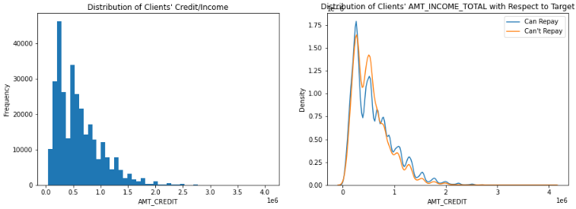
Business Insight from Data
Is there relation between Amount Credit and ability to repay?
Clients amount credit under 1 are more likely to have difficulties with repay, where those aged more than 1 can repay well.

Slide 18
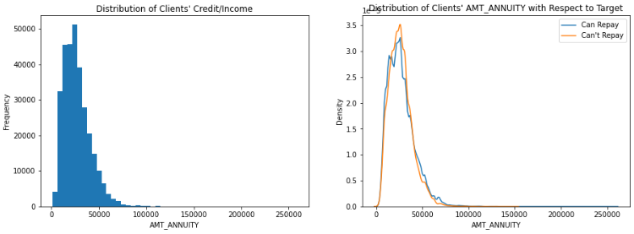
Business Insight from Data
Is there relation between Amount Annuity and ability to repay?
Clients amount annuity about 30000-40000 are more likely to have difficulties with repay, where those amount annuity over 50000 can repay well.

Slide 19
Data Pre-processing

Slide 20
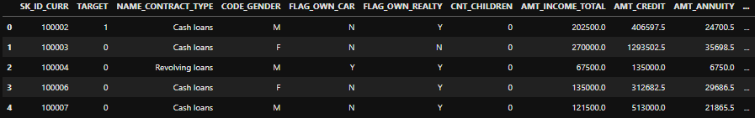
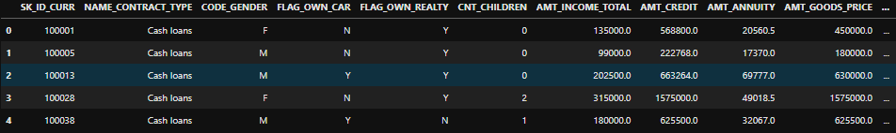
Pre-processing
Data shape:
Train: 307511 Rows and 73 columns
Test: 48744 Rows and 72 columns

Slide 21
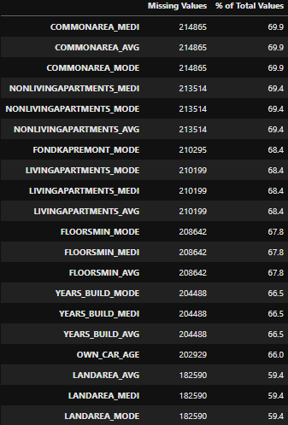
Handling Missing Values
When it comes time to build our machine learning models, we will have to fill in these missing values (known as imputation). In later work, we will use models such as XGBoost that can handle missing values with no need for imputation. Another option would be to drop columns with a high percentage of missing values or we can replace missing values with mean in numerical values and mode in categorical values.

Slide 22
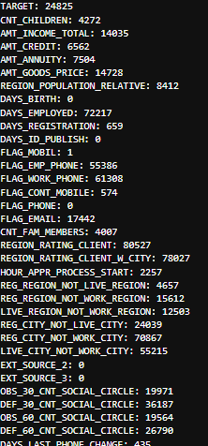
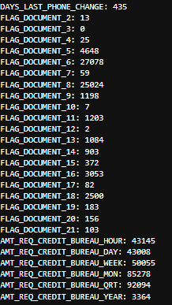
Manage Outlier
Handling outlier with upper outlier and lower outlier

Slide 23
Other Process in Pre-processing
Manage Duplicate Data
Delete all duplicates data in train and test
Normalization using MinMax Scaler
Feature Selection
Drop Organization_type because there’s to many missing values
Encoding in categorical values

Slide 24
Feature Engineering
Here we can create a new feature to find out the ratio of their income to the total loan and also the percentage of their credit with their income. This table can be useful to find out what percentage of the total loan and income ratio of those whose installment payments are more than the specified day (Target = 1).
From this table we can also see whether the loan amount requested by the client exceeds their total income, causing the client to default > 30 days.

Slide 25
Modelling

Slide 26
Modeling with tuned hyperparameters
We used Random search for tuning hyperparameters
Split data; Train 70 : 30 Test
We used 3 model to predict AUC Score
LGBM Classifier
XGB Classifier
AdaBoost Classifier

Slide 27
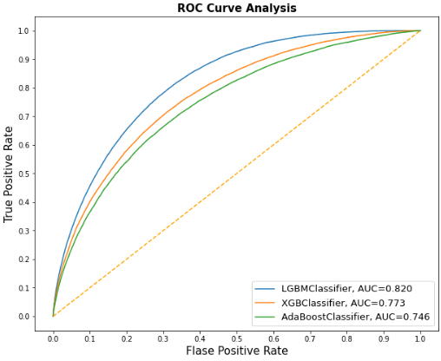
Results
The best model is LGBMClassifier with AUC 82%

Slide 28
Light Gradient Boosting Machine
We can step off the deep end and use a real machine learning model: the gradient boosting machine using the LightGBM library! The Gradient Boosting Machine is currently the leading model for learning on structured datasets (especially on Kaggle) and we will probably need some form of this model to do well in this project. In the next step, we will see how to work with more advanced models (which mostly means adapting existing code to make it work better), feature engineering, and feature selection.

Slide 29
THANKS

